Slide 1

HealthProof
Avalanche BUILD GAMES EDITION
Verifiable medical documents. Privacy by design.

Slide 2
Problem
Solution
Digital health operates with fragmented documents
Exams in PDFs, WhatsApp, or on paper.
There is no standard test of authenticity.
Digital sovereignty for patients
In Chile, laws on personal data protection 21.719 and medical record interoperability 21.668 come into effect.
Web3 verification layer for medical documents.

Slide 3
We guarantee trust
Business model B2B
Patient
Data owner
Manages permissions
Health center
Laboratory
Issues signed orders
Uploads exam results

Slide 4
B2B Model
TAM
USD 1.5–3 billion annually
Digital health in Latin America (verification infrastructure)
SAM
USD 250–600 million annually
Focus use cases (Chile + Latin America)
SOM
USD 3–10 million ARR
1–2% market share for SAM LatAm in 5 years

Slide 5

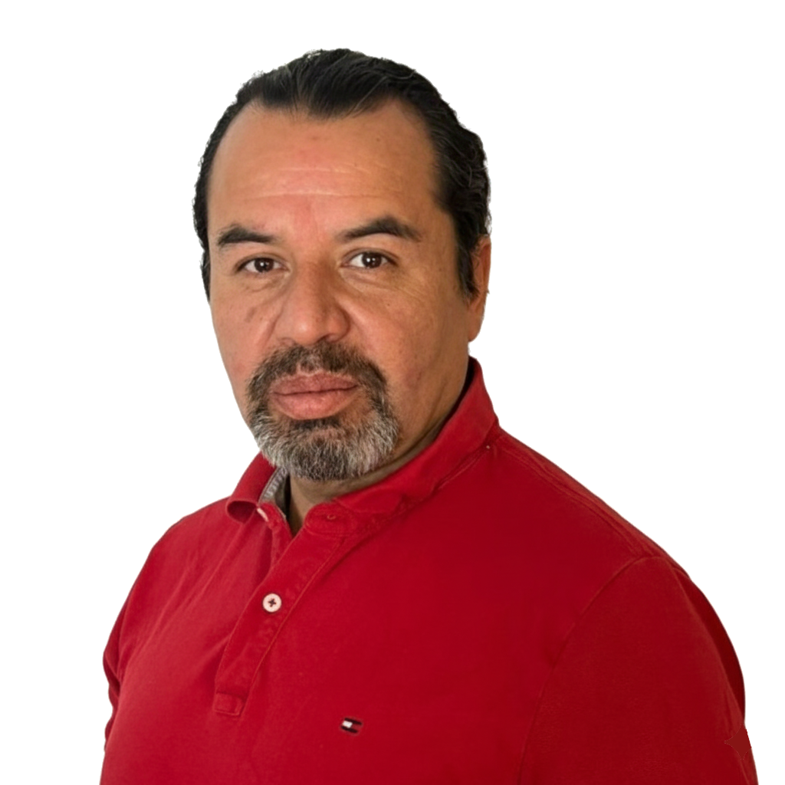









Team
Catalina Orellana
Pablo Guzmán
Danilo Contreras
Andrés Peña
CEO | LinkedIn
CTO | LinkedIn
CPO | LinkedIn
CMO | LinkedIn

Slide 6
HealthProof
The new verification standard that allows anyone to check medical documents in seconds.
pablo@innovaxchain.com

